Slide 1
Natural Language Processing (NLP)
Lecture 13: Representation Schemes
Dr. Muhammad Taimoor Khan

Slide 2
Text Representation Schemes
Binary
Frequency
Caped-Frequency
Lower bound
Log-Frequency

Slide 3
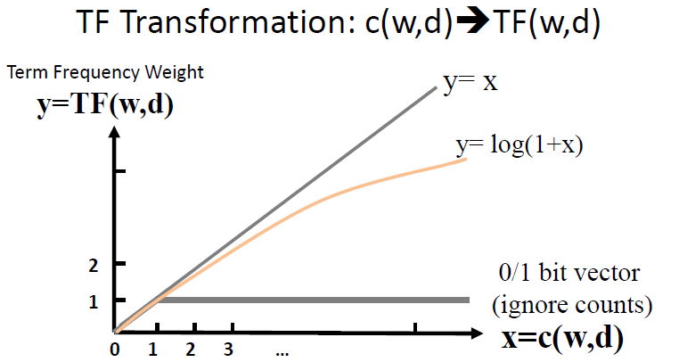
Comparison of TF Transformation

Slide 4

BM25 Scheme
Count term frequency
Convert to BM25 using formula,
$$y=\frac{\left(k+1\right)x}{k+x}$$
Its value will never exceed k+1
Advantage of BM25 is that the upper limit can be controlled as desired

Slide 5
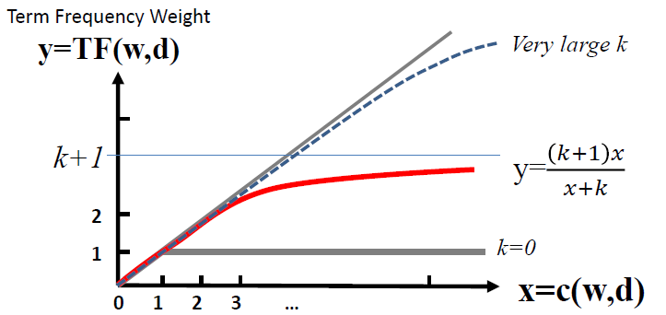
BM25 Transformation of TF

Slide 6
Issues with Considering Frequency only
All of the studied schemes prefer frequency
But its not only the significant words that have more information
The most frequent words are usually found to be the stop words that have somehow escaped pre-processing
Even if not that, they still do not provide enough information as they are somewhat uniformly distributed across most documents
That is, features NOT BEING GOOD DISCRIMINATORS

Slide 7
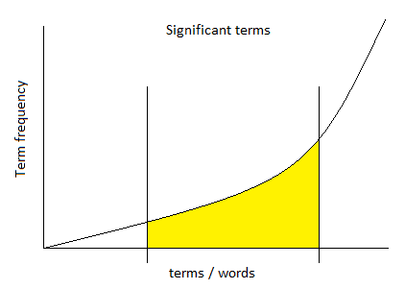
Significant Words
In ML / DM we desire features which are good at discriminating among the target labels
In text we can call them significant words
Words that dominantly represent a label
High frequency words: Too frequent -> not good features
Low frequency words: Too infrequent -> not good features (usually represent noise)
So what should we look for!

Slide 8

TF (Term Frequency)
Term Frequency (TF):
$$TF(w)=\frac{count(w in doc)}{doc size}$$
The denominator is to normalize for variable size documents
High frequency is decided with respect to a document

Slide 9
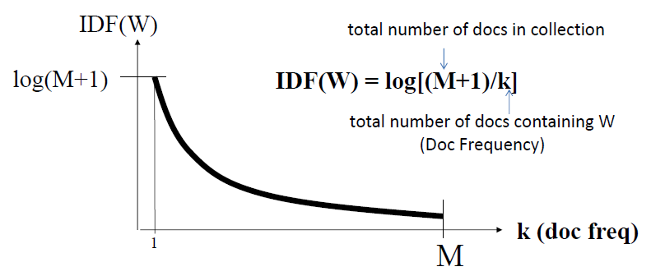

IDF (Inverse Document Frequency)
Inverse document frequency verifies the presence of a term across all the documents in the corpus
Therefore, verifying if the term is frequent in a document, is it frequent across most of the other documents as well. If so, then its not very helpful
$$IDF(w)=log\left[\frac{M+1}{k}\right]$$
M: Total documents in the corpus
k: Documents containing term w
Penalizing popular terms!

Slide 10
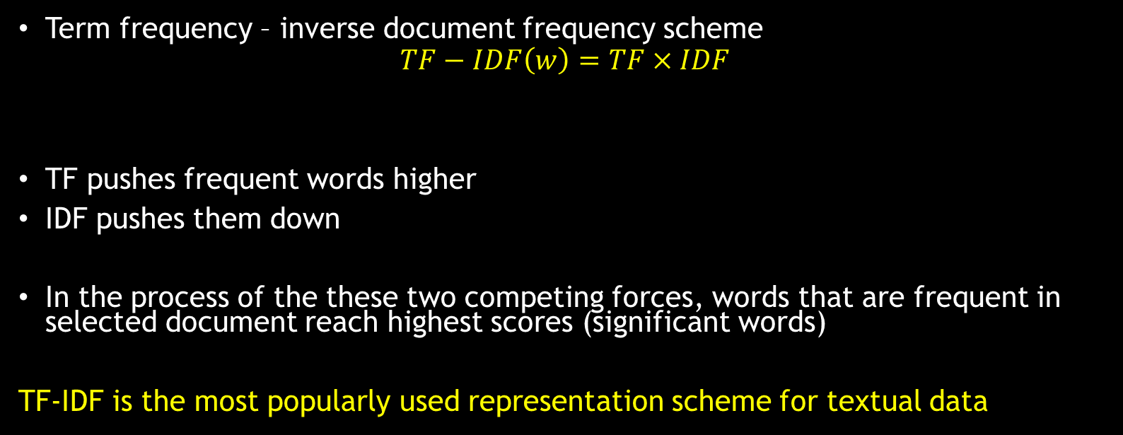
TF-IDF
Term frequency – inverse document frequency scheme
$$TF−IDF\left(w\right)=TF×IDF$$
TF pushes frequent words higher
IDF pushes them down
In the process of the these two competing forces, words that are frequent in selected document reach highest scores (significant words)
TF-IDF is the most popularly used representation scheme for textual data

Slide 11
Building Training Data
Building a training dataset for prediction model requires an additional column for labels
The test document is evaluated for its similarity to the documents of each label
Dataset

Slide 12
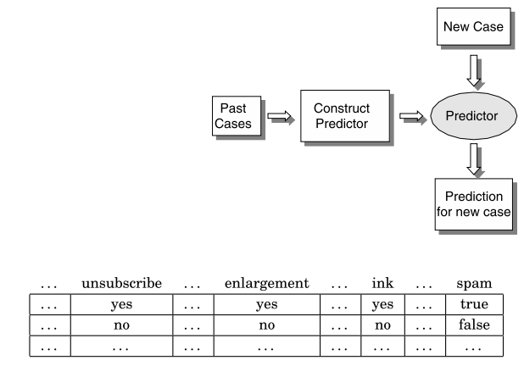
Prediction or Forecasting
Learning from samples of past experience and projecting on new examples
The future has to be similar to the past
Inductive learning approach
Dominant approach in machine learning

Slide 13
Inductive learning vs Deductive learning
Inductive learning
Specific examples → Generalized rules
Deductive learning
Generalized rules → Specific examples

Slide 14
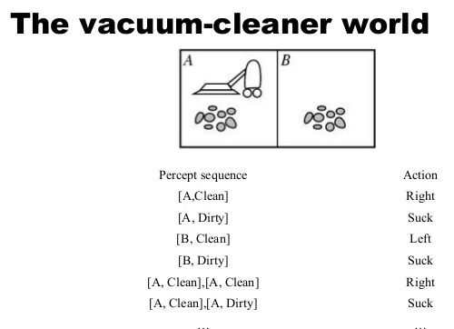
Look-up Table
Earlier approach
Lookup table (closed world / limited possibilities)
Only works for an already known case
Cannot handle new similar but not same data

Slide 15
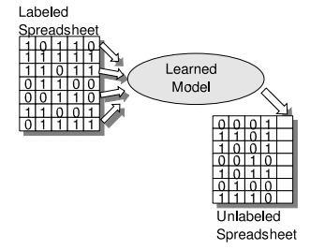
Machine Learning
Learn popular patterns in training data
Use these patterns to distinguish among the given labels
Evaluate on the test set
See how good the model can distinguish among the labels for an unknown instance

Slide 16
Issues with Machine Learning
do not learn from basic principles
May learn wrongly
Lack the ability to reason and reach new conclusions for new situations
Can learn generalized patterns for enough diversity
Has produced reliable solutions for most prediction problems
A classical prediction problem for text is called text categorization (now called text classification)

Slide 17
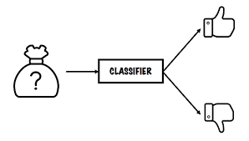
Text Categorization (Classification)
Assigning a new unseen document to one of the predefined fixed categories
Categories (Labels) – Can be anything in given nature of application
Rare words that are distinctive and can better discriminate have high predictive quality and ensure higher accuracy
Classical categorization: Binary Classification (2 labels)

